Slide 1
Working with Devices

Slide 2
Agenda
Using Cloud Devices – selecting & reserving devices.
Basic Device operation – touch, text entry, rotation, session recording & sharing.
Widgets – location, screenshots, applications.
Advanced features – network services, cloud services.
Notes:
This module takes a peek at Perfecto’s interactive application. Our goal is to present a range of features which we can them include within our tests. All of the functionality presented is also available to be executed by code.

Slide 3
Using Cloud Devices

Slide 4
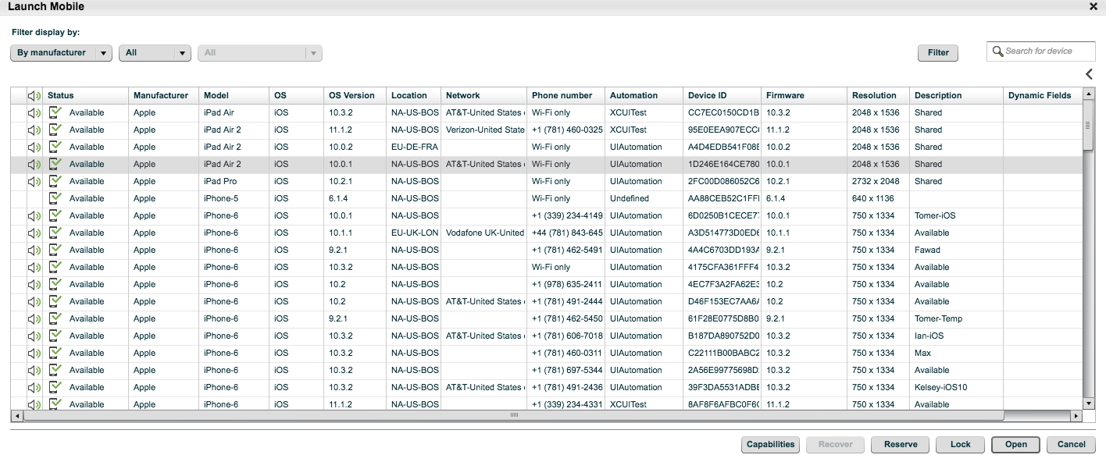
Selecting a Device
Toggle Device Information
Filters by
Sortable Columns
Auto Search Properties
Device Status
Capabilities Settings
Schedule Reservation
Audio Connected
Reserve Now
Use Now
Notes:
Instructor notes:
============
Let’s being by launching a device (Mobile or Web)
Explain Audio Connection
Explain Device Status
Available, Opened, Busy, disconnected,
Explain the Sortable columns = Model, OS, Network, Device ID, Firmware, etc.
How to Reserve, or lock down…
Allow 24 hours lead time
Open to use now, double click on selected device
Device Capabilities, how it
You can open multiple device, each device open required 256K download bandwidth

Slide 5
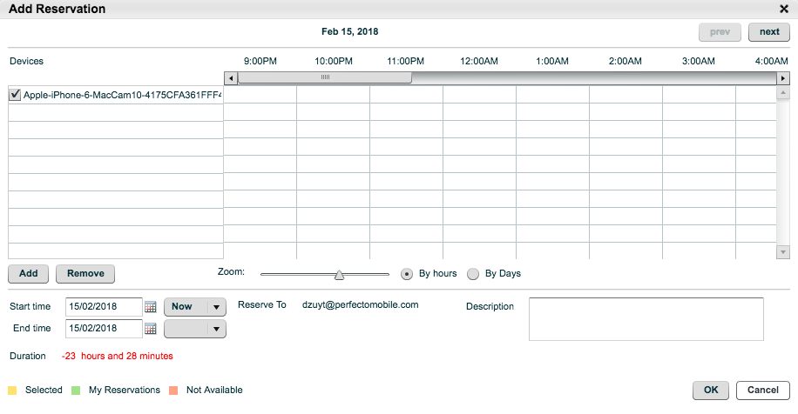
Reserving a Device
NOTES: To access Reservations administration:
From the application menu, select MORE - -> ADMINISTRATION
From the Tabs menu, select RESERVATIONS
2. Click the Add button to add the reservation to the device
1. Select the date and the time that you wish to reserve the device for
3. Click OK to complete the reservation
NOTES: * If you are using a device that was not reserved, and another user reserves it during this time, your session will stop immediately.
Notes:
Instructor notes:
============
Reserving a device just made for you.
Other people will see the device busy at that period of scheduled time
On public cloud the hourly deductible for the total time token , so 1 token = 1 minutes.

Slide 6
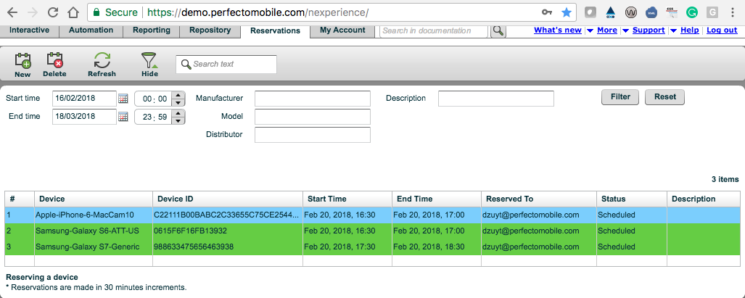
Editing or Deleting a Reservation
Editing a Reservation:
Go to the reservations tab and highlight the reservation
From the icon bar, click the New icon
Or click Edit Parameter settings as required
Deleting a Reservation:
Go to the reservations tab and highlight the reservation
From the icon bar, click the Delete icon and Confirm
Note: Pop-up reminder regarding to adjust token balance.
Notes:
Instructor notes:
============
Using the Arrow to expand or collapse
Explain

Slide 7
Operating Devices
Notes:
DEVELOPER NOTE
Hot spot on Chrome icon to link to http://www.google.com/chrome

Slide 8
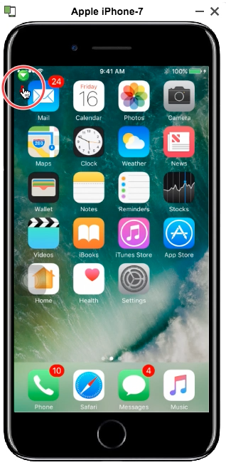
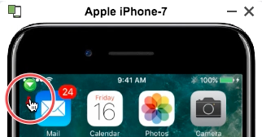
Operating Devices - Key Press / Touch
To press any button on the device:
Just Click
To tap or touch the screen:
Just Click
To perform a long touch or key press touch:
Combine a click with a CTRL hold.
For MAC, use COMMAND key
Will appear at the top left of the device
What is the different between a KEY PRESS and TOUCH?
Notes:
Instructor notes:
============
You should demonstrates on both Android and IPhone, because Android can shows power button
To press any button or physical keys on the device - click it.
To tap or touch the screen - click it.
Certain actions on the device require a long touch or key press. To perform a long touch or key press, hold the CTRL key and click on the device.

Slide 9
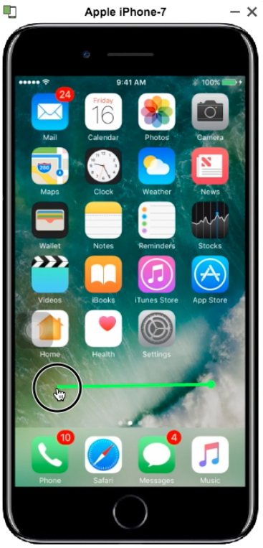
Operating Devices - Swipe
SWIPE – Hold down the SHIFT key and drag the mouse on the device screen in the desired direction.
ABOUT SWIPE
Marked with a GREEN line
Hold down the SHIFT key and drag the mouse in the desire location (which receives the start and end coordinates and the time interval – the faster the move, the further the Scroll)
Connects Point A to Point B, with no other coordinates in between, in a straight line
Notes:
Instructor notes:
============

Slide 10
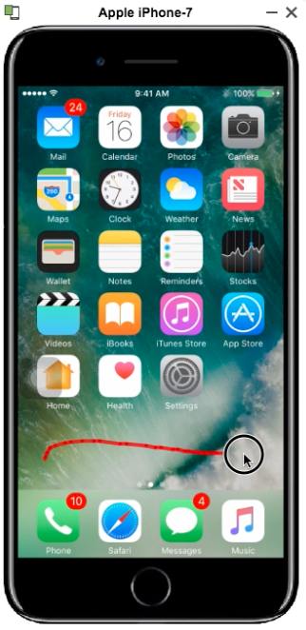
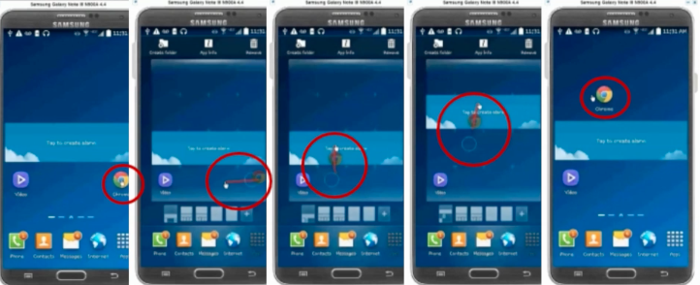
Operating Devices – Scroll / Drag
SCROLL – Click and move your mouse in the desire direction
DRAG – Click on an icon, move your move slightly until is responsive and then drag.
ABOUT SCROLL / DRAG
Both are marked with a RED Line
Allows movement of an object in a non-linear way
This operation provides the system with a series of coordinates within a vector; from A to B and everything in between.
Look for the CHROME Icon
Notes:
Instructor notes:
============
DRAG – Click on an icon and hold for 2-secs, then wiggle to get responsive.

Slide 11
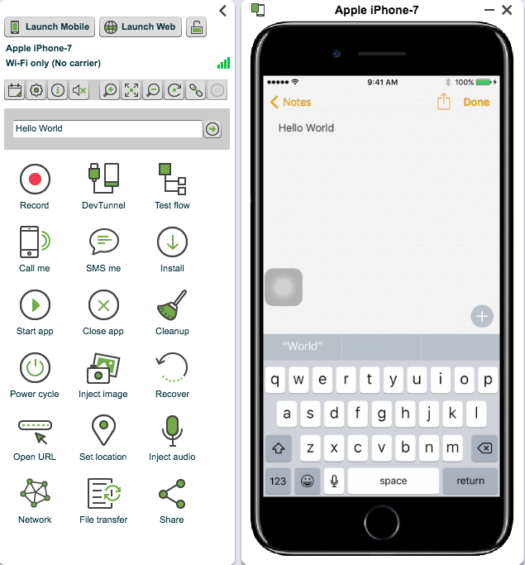
Text Entry
To use Text Entry mode
The device should be in text-entry mode
This means that either:
The virtual keyboard is open
Or the cursor is waiting for text
In most devices, text enter can be completed in any language supported by the device. The Text is sent directly to the operating system, disregarding the Virtual Keyboard.
In some devices, typing the text at the dialing screen may not be supported. For these devise , the keypad can be used.
2. Type text in the textbox
1. To Input Text - Select a location to enter (or simply press ENTER key on you keyboard)
3. Click to enter text
Notes:
Instructor notes:
============
Click on Notes Application
Place your pointer to a location
Type your text
Click Enter to add text

Slide 12
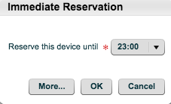
Key Features to Know About: Device Rotate, Device Information, Device Audio
Make Reservation
Freeze Screen (Digital)
Copy the direct link of the device to the clipboard
Settings
Position
Display information for selected device, information includes device details, capabilities, reservations, and usage tips
Zoom Out
Zoom Options
Unmutes device audio, Note: By default, device audio is muted when device is first opened
Zoom In
Notes:
Instructor notes:
============
Go thru those icon quickly
The blue are the most frequent used

Slide 13
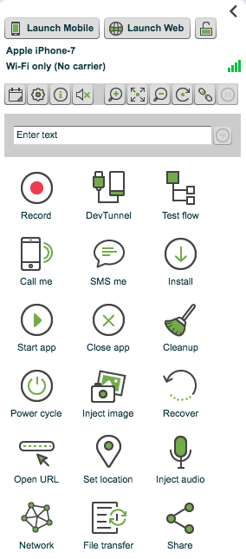
Restart and Recovery
Rebooting the Device
Recover a device by clicking on the POWER CYCLE widget
This can be used if the device freezes or for a fresh start
RECOVER:
Disconnects and reconnects the device to the CQLab
Use this ONLY if restarting a device did not work.
In case of persistence failure, please open a support ticket
RESTART/POWER CYCLE:
Performs a software restart of the device by using the Power Cycle widget
Use when needed in a test case or on an unresponsive device
While the device is rebooting you CANNOT perform operations.
If you attempt an operation, an error may appear.
Notes:
Instructor notes:
============
RECOVER:
Disconnects and reconnects the device to the CQLab
Use this ONLY if restarting a device did not work.
In case of persistence failure, please open a support ticket
RESTART/POWER CYCLE:
Performs a software restart o f the device by using the Power Cycle widget
Use when needed in a test case or on an unresponsive device
While the device is rebooting you CANNOT perform operations.
If you attempt an operation, an error may appear.

Slide 14
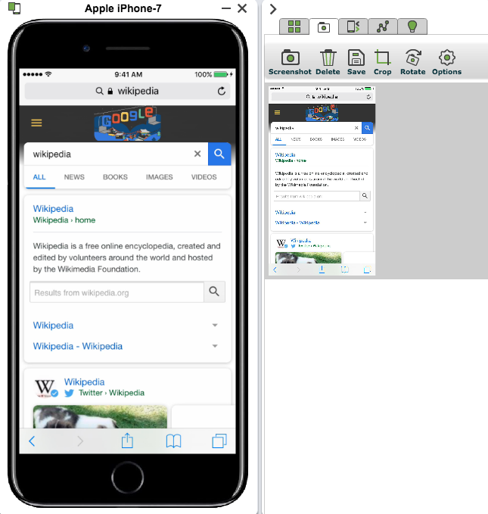
Screenshots
The SCREENSHOT feature capture digitals snapshots of device screens.
To Capture a Screenshot:
Select the SCREENSHOT tab.
Click the SCREENSHOT to take digital snapshot of the device screen.
Screenshot Basics
Manipulate he screenshot by cropping or rotating
Click SAVE and choose a saving method:
What is the Repository?
The Repository is your CQLab storage space. You can save images with their device skin here. You can also store your applications, data tables, scripts, and test flows. This is useful when sharing screenshots maybe required for demo purposes.
Notes:
Instructor notes:
============

Slide 15
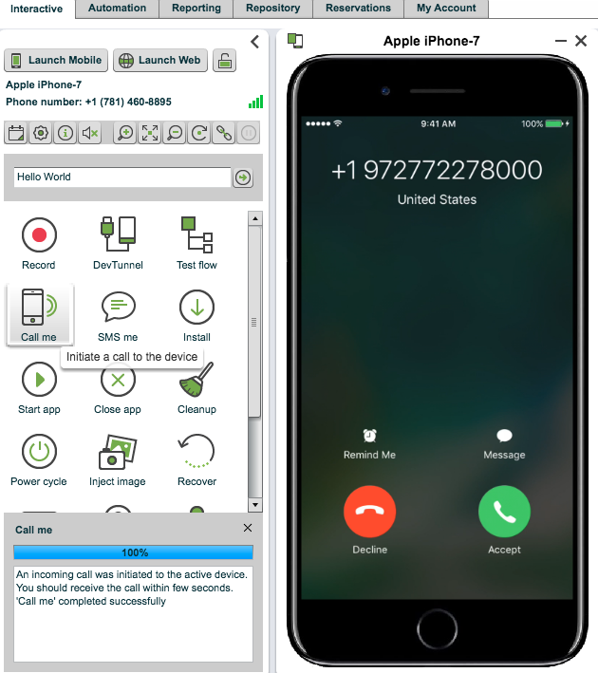
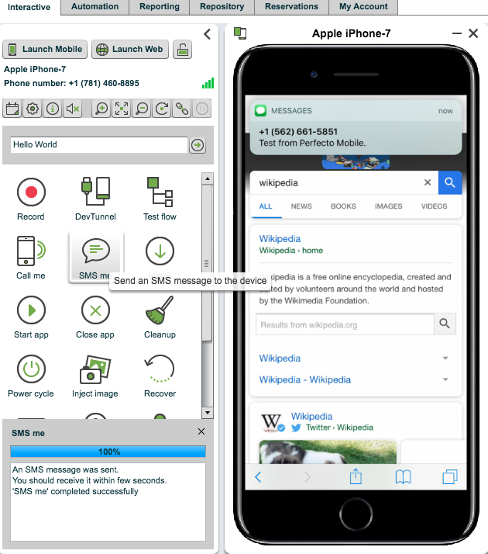
Cloud Services
Cloud Services allow user to see how a device responds to runtime events, such as an incoming call and an SMS.
They are simulation of every day situation while an application is running
Available on hosted and public clouds only.
To call or SMS a device:
* Allow the system and the device some processing time to complete any request.
Notes:
Instructor notes:
============
http://developers.perfectomobile.com/display/PD/Device+operations
http://developers.perfectomobile.com/display/PD/Device+operations#Deviceoperations-CloudServices

Slide 16
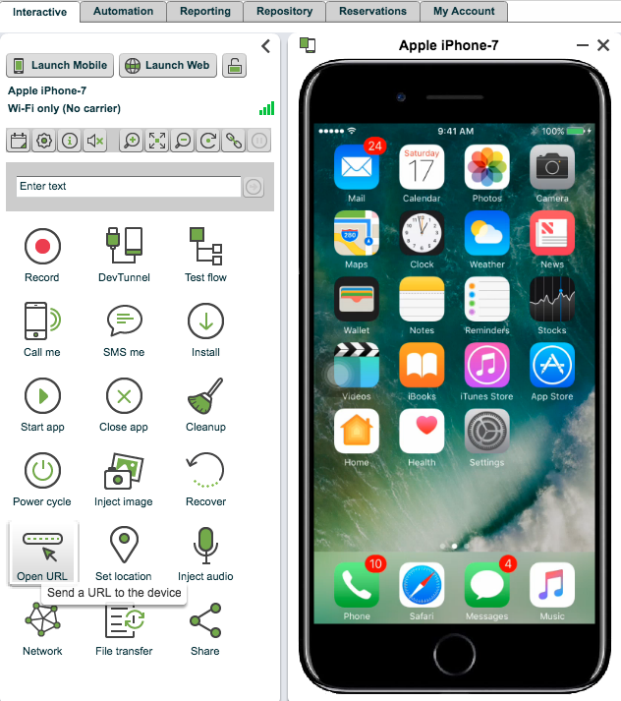
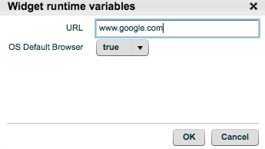
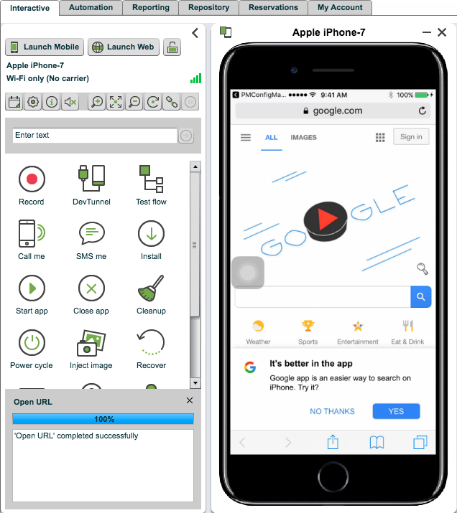
Websites Services
A windows opens, where you will be able to enter the URL that you want the device to browse to, and click OK
The Open URL widget opens a browser and navigates to the specified URL
A device browser will open and displays the URL site…
Notes:
Instructor notes:
============

Slide 17
Widgets

Slide 18
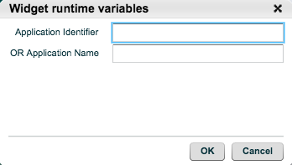
Applications Widgets
Start / Close Application
Note: START and CLOSE require the Application Identifier or Application Name.
Install Application
Installs the application from the repository or your local PC
Notes:
Instructor notes:
============

Slide 19
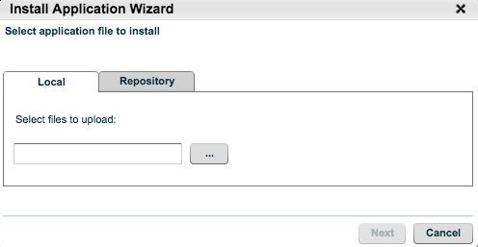
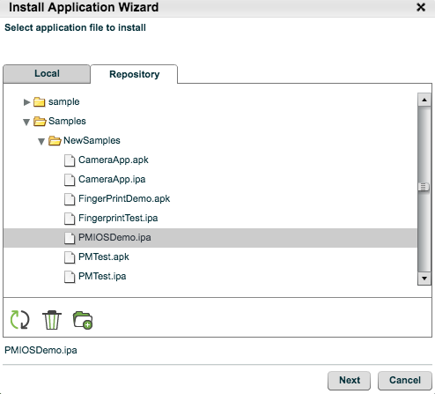
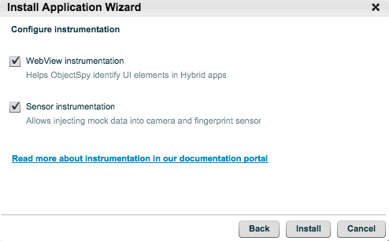
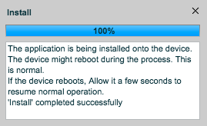
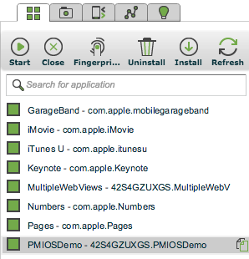
Install Application Wizard
This widget allows you to directly install your application onto the active device
Select the application to install
Press “…” to select the application from your PC
Alternatively, you can manage your applications in your repository by selecting the “Repository” tab and uploading multiple applications into your repository
Press ”Start” to start the application
Notes:
Some installations might reboot the device, this is normal
1. Select you application file from your PC
2. Or from CQL repository, in this example is from PUBLIC/samples folder, and PMIOSDemo.ipa file
3. Configure the app instrumentation options.
4. Progress of app install completion.
5. Verify the app has installed.
Notes:
Instructor notes:
============
By default, the upload maximum application size is 100MB, to increase submit a ticket to increase the upload size.
On Step #2, you can select and file from PUBLIC or PRIVATE Folder
Explain the different between the folders
PRIVATE folder for your own personal use
On the last step #5
If the Application Identifier is unknown, us the device Applications List to get the list of Installed application, and then RUN the command directly from the list.
Show where you can get the ”Application List icon, it is located on the right side of the screen… the icon with 4 square box.

Slide 20
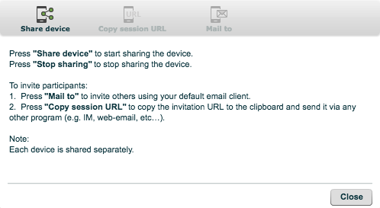
Working in a Team – Sharing a Session
Sharing a Session
The SHARE features allows a user to grant simultaneous viewing access to multiple participants.
This is useful for collaboration teamwork.
During a shared session, the hosting user has access to control the device
Additional share windows are restricted to view only, and do not need credentials to log-in.
2. Click on Share device icon will enable other icon it its menu, and to start sharing the device.
3. To end the sharing session, click on “Stop sharing”
4. These icons are for user to forward the share session information.
1. Click on SHARE icon to start the sharing session.
Notes:
Instructor notes:
============
Working the device manually in your hand, has limitation and can affect collaboration, sharing of information to other team member, management, and other business units.
Let’s spend few minutes on those features that can eliminate the bottleneck in your organization

Slide 21
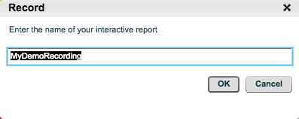
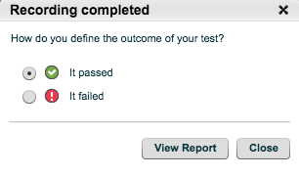
Recording a Session
Record a Session
The Record feature saves the video of an interactive session.
This tool can be used for preparing promotional videos for application as part of the marketing strategy, capturing working examples, capture manual test workflow, and capture issues and findings.
2. A dialog box appear to allows user to specify a file name to be saved, then click OK
3. Note: The Record Icon will turn into “Stop Record”… When finish and user want to stop, then click on Stop Record widget to finalize the recording.
4. A dialog box appear to allow user to selection as passed/failed option of this test recording. This will record the result on the Single Test Run Report.
1. Click on RECORD icon to start the recording session.
5. A final option to allows user for viewing the report now, or just close it and review the report later.
Notes:
Instructor notes:
============
Instructor: Demonstration is needed to show where the Report resided
- Explain the Report location
For On-Prem Solution, the Report is saved on MCM server
Menu Reporting Tab -> Open -> Private -> MyReports is either in (Interactive or RemoteWebDriver) folder
For Hybrid or Cloud Solution:
The Report is saved and published to AWS Cloud Report Server (DigitalZoom)
To access -> Menu Reporting Tab -> Click NEW GO TO REPORTING APP, this will takes you to the AWS report server

Slide 22
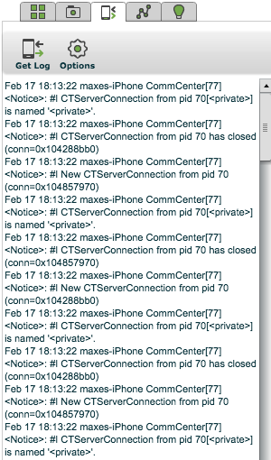
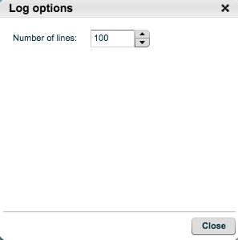
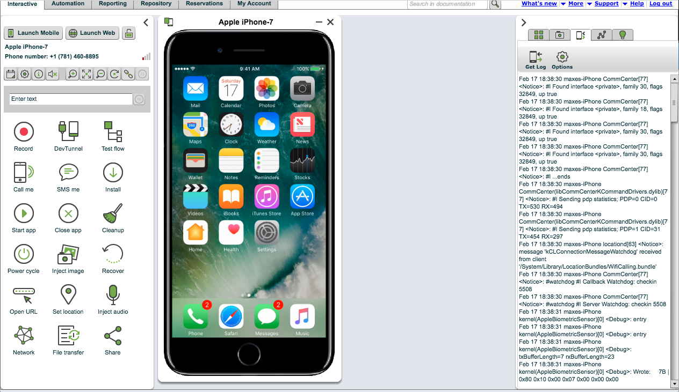
Other Functionality - Logs
Logs
The logs feature allows a user to review the OS log.
Examples log data includes:
MEMORY and FAILED INSTALLATION of Application
The Logs menu tab is located on the right side of the CQL Browser
1. Click on LOG icon to select log utility.
2. Click on Options icon change the number of lines to be displays at a time.
3. Click on GET LOG to start displaying the most recent logs from the device.
As an enhanced security feature, the device logs are cleared once the session is ended.
To search and edit the log with any external text editor, select and copy the log text into the clipboard.
Notes:
Instructor notes:
============

Slide 23
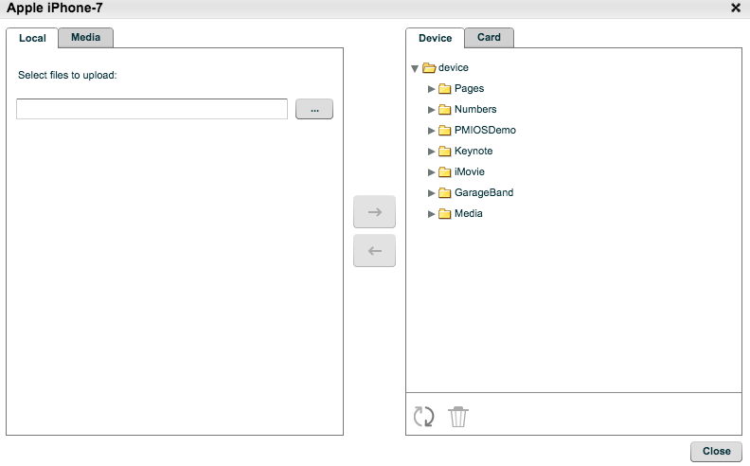
Other Functionality – File System
File Transfer
Use the FILE TRANSFER widget to upload files to or download files from the device.
2. The function support Put, Get, Delete file operations from the device to the local PC, or CQL Media Repository
Notes:
Most devices will not allow copying files to restricted locations. For example, Android devices will only allow copying files to the memory card.
Single or multiple files can be transferred.
3: For Device with External SD Card, click on device Card Tab to access its files and folders.
1. Click on File Transfer perform file transfer operations.
Notes:
Instructor notes:
============

Slide 24
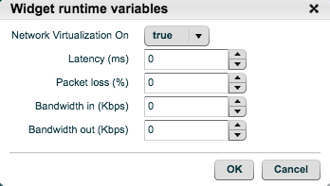
Other Functionality – Network
2. Runtime variable values
Latency values are in the range of 0-8000 ms.
Packet loss values are in the range of 0-100%. A reasonable packet loss value should not exceed 5%.
Bandwidth in/out values are in the range of 3-100,000 Kbps, or unlimited.
Network Virtualization
The Perfecto Mobile network virtualization mechanism examines the impact of different network conditions.
Use the Network widget to change the network conditions on the device and get critical insights to end-user experiences.
3. Emulation of Problematic networks
Problematic Level | Packet loss (%) | Corruption (%) | Duplication (%) | Reorder
Noisy Network | 2 | 2 | 0 | 5
Steady Network | 1 | 0 | 0 | 2
Unstable Network | 3 | 3 | 2 | 10
Very Unstable Network | 5 | 5 | 5 | 20
1. Click on Network Widget to setup the emulation parameters.
Notes:
Instructor notes:
============
Netem provides Network Emulation functionality for testing protocols by emulating the properties of wide area networks.
The current version emulates variable delay, loss, duplication and re-ordering.

Slide 25
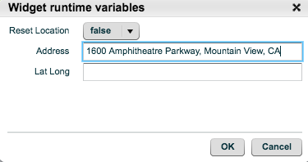
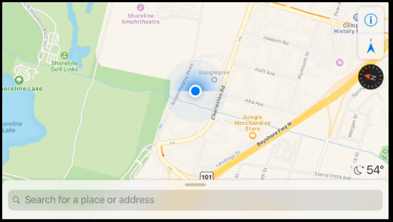
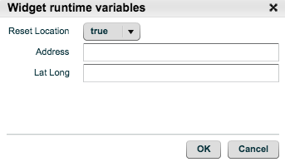
Other Functionality – Set and Reset Device Location
2. Insert the location address (using Google Geocoding format) or coordinates (Latitude, Longitude format) and click OK. Example address:
1600 Amphitheatre Parkway, Mountain View, CA Example Lat, Long coordinates: 43.642659,-79.387050
Set Location
Set device location allows developers to test applications that use location services.
Reset location allows developers to stop setting the device location, and return the device to its current location.
3. The Map should be showing a new GPS location
1. Click on Set Location Widget to perform GPS mocking to a location.
4. Click SET LOCATION widget again, and change Reset Location to TRUE. This will reset the GPS back to it true location.
Notes:
Instructor notes:
============

Slide 26
Resources
Device Operations
http://developers.perfectomobile.com/display/PD/Device+operations
Launch Device
http://developers.perfectomobile.com/display/PD/Launch+device
Reboot and Recovering
http://developers.perfectomobile.com/display/PD/Device+operations#Deviceoperations-RebootandRecoveraDevice
File Transfer
http://developers.perfectomobile.com/display/PD/Device+operations#Deviceoperations-FileTransfer
Select Location
http://developers.perfectomobile.com/display/PD/Device+operations (On this page)
Network Virtualization
http://developers.perfectomobile.com/display/PD/Network+virtualization+start
Recording
http://developers.perfectomobile.com/display/TT/Recording+a+Session
Notes:
Instructor notes:
============

Slide 27
Thank You

